Slide 1


Slide 2
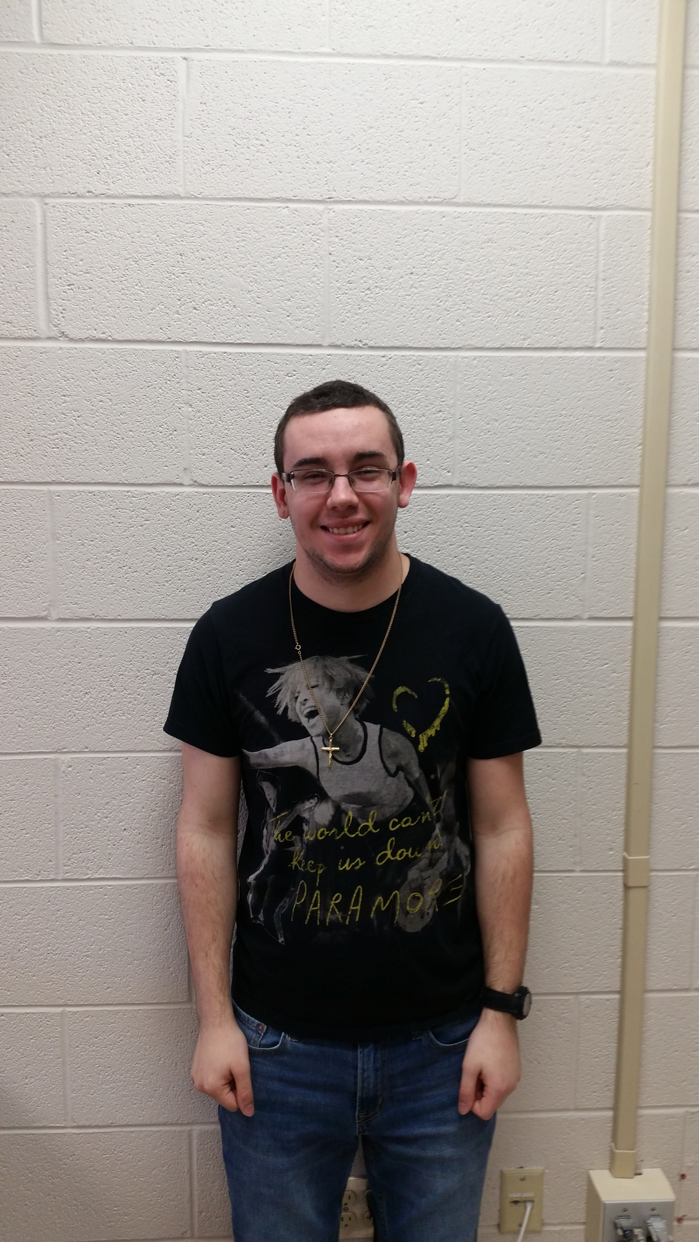
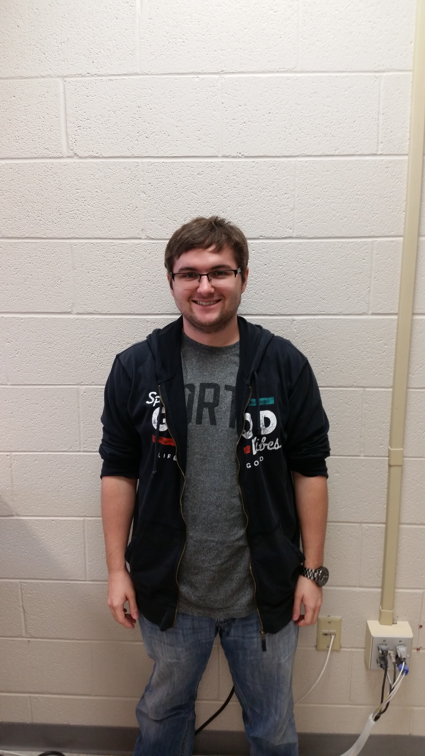
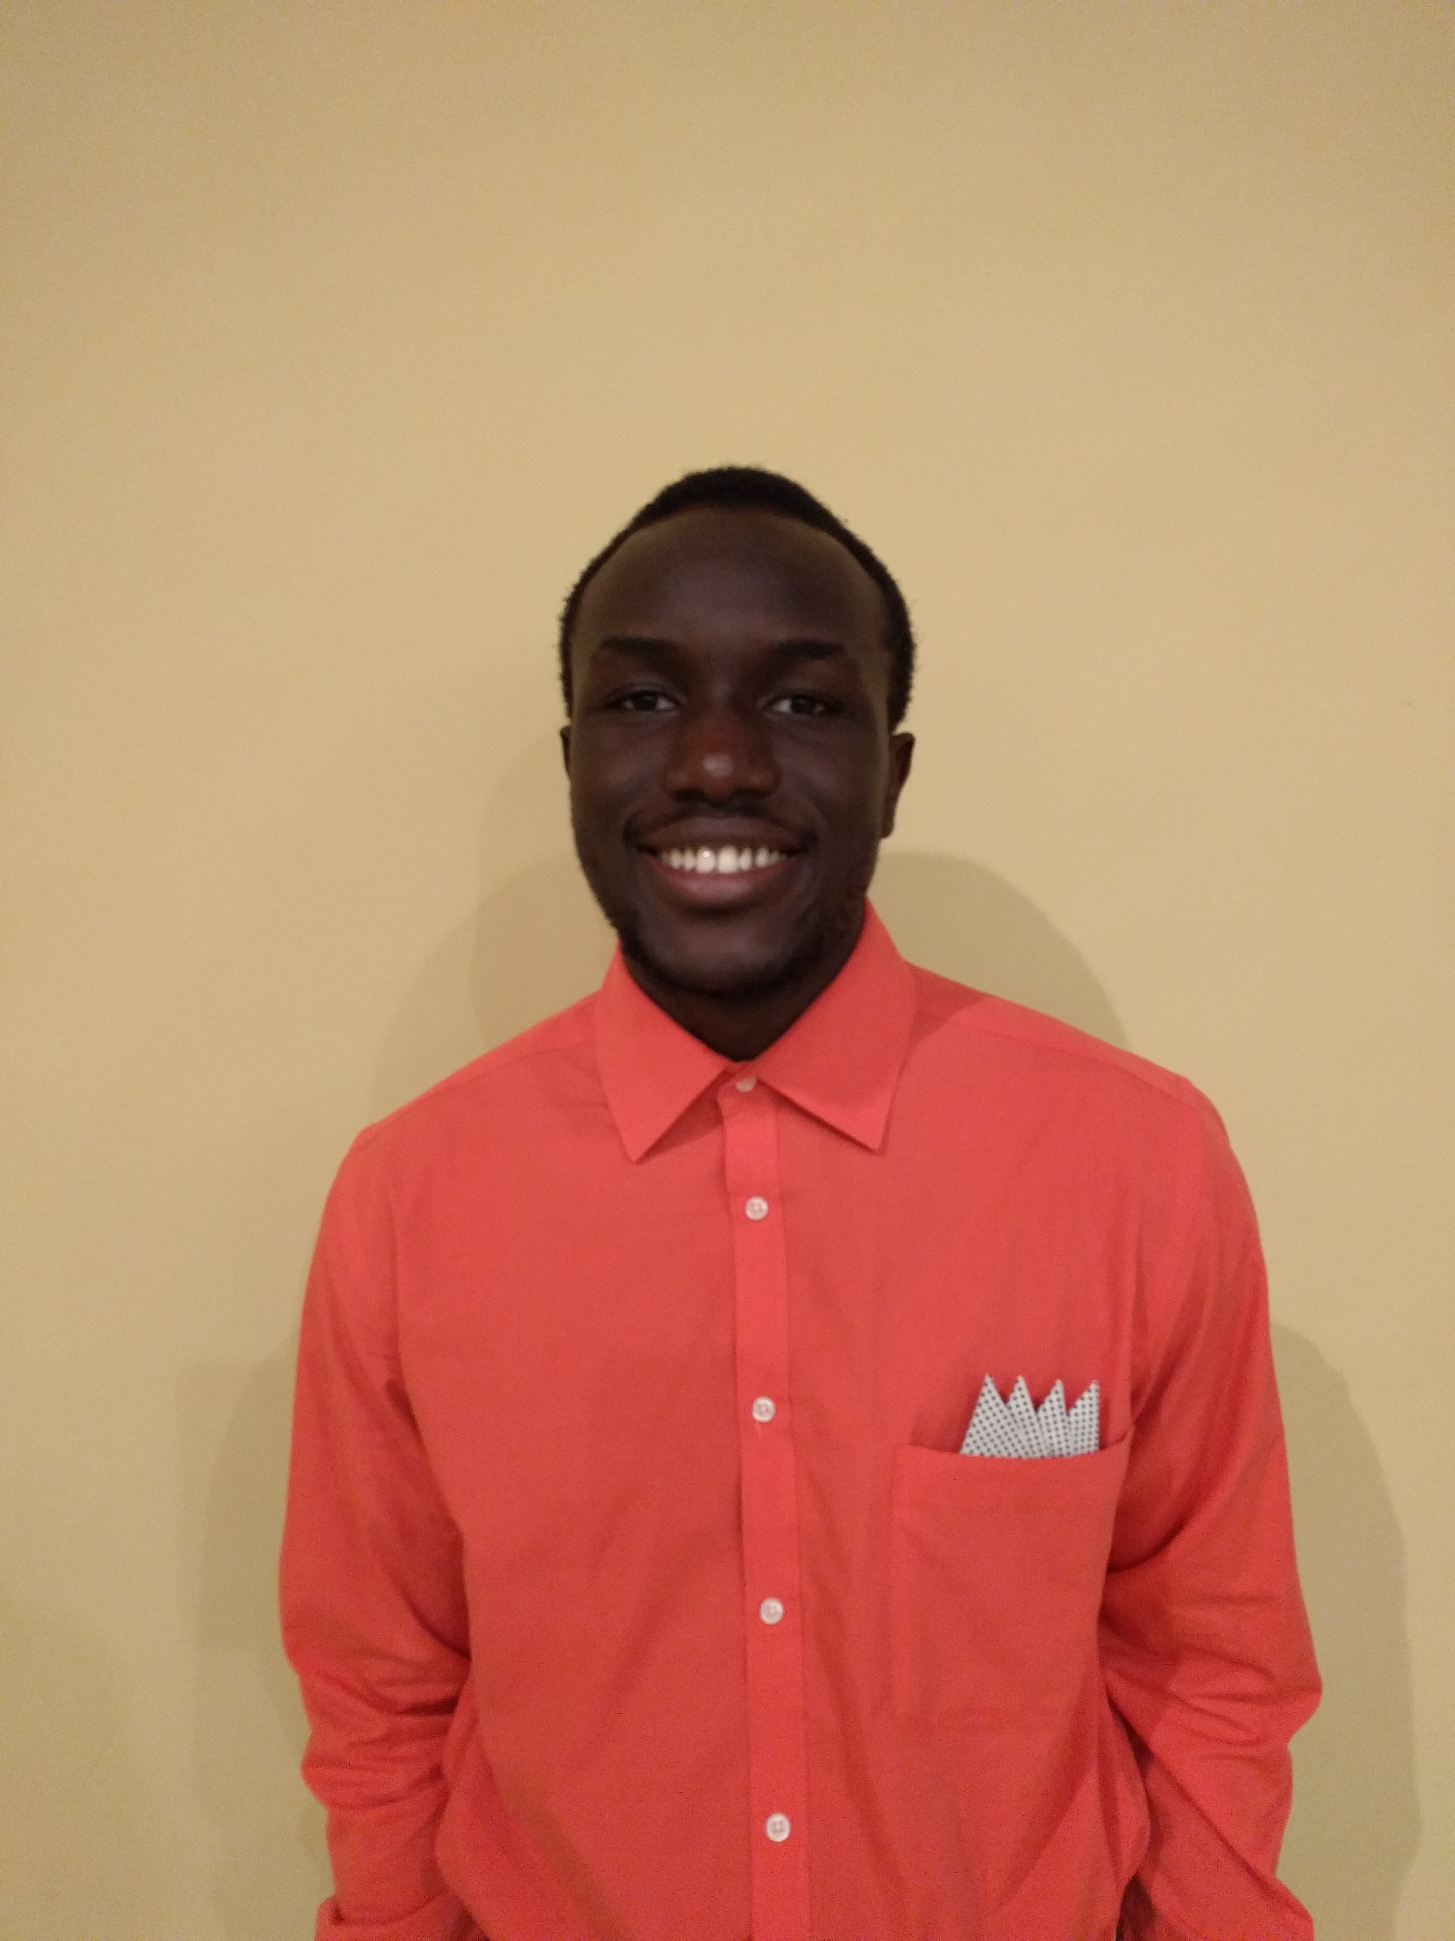
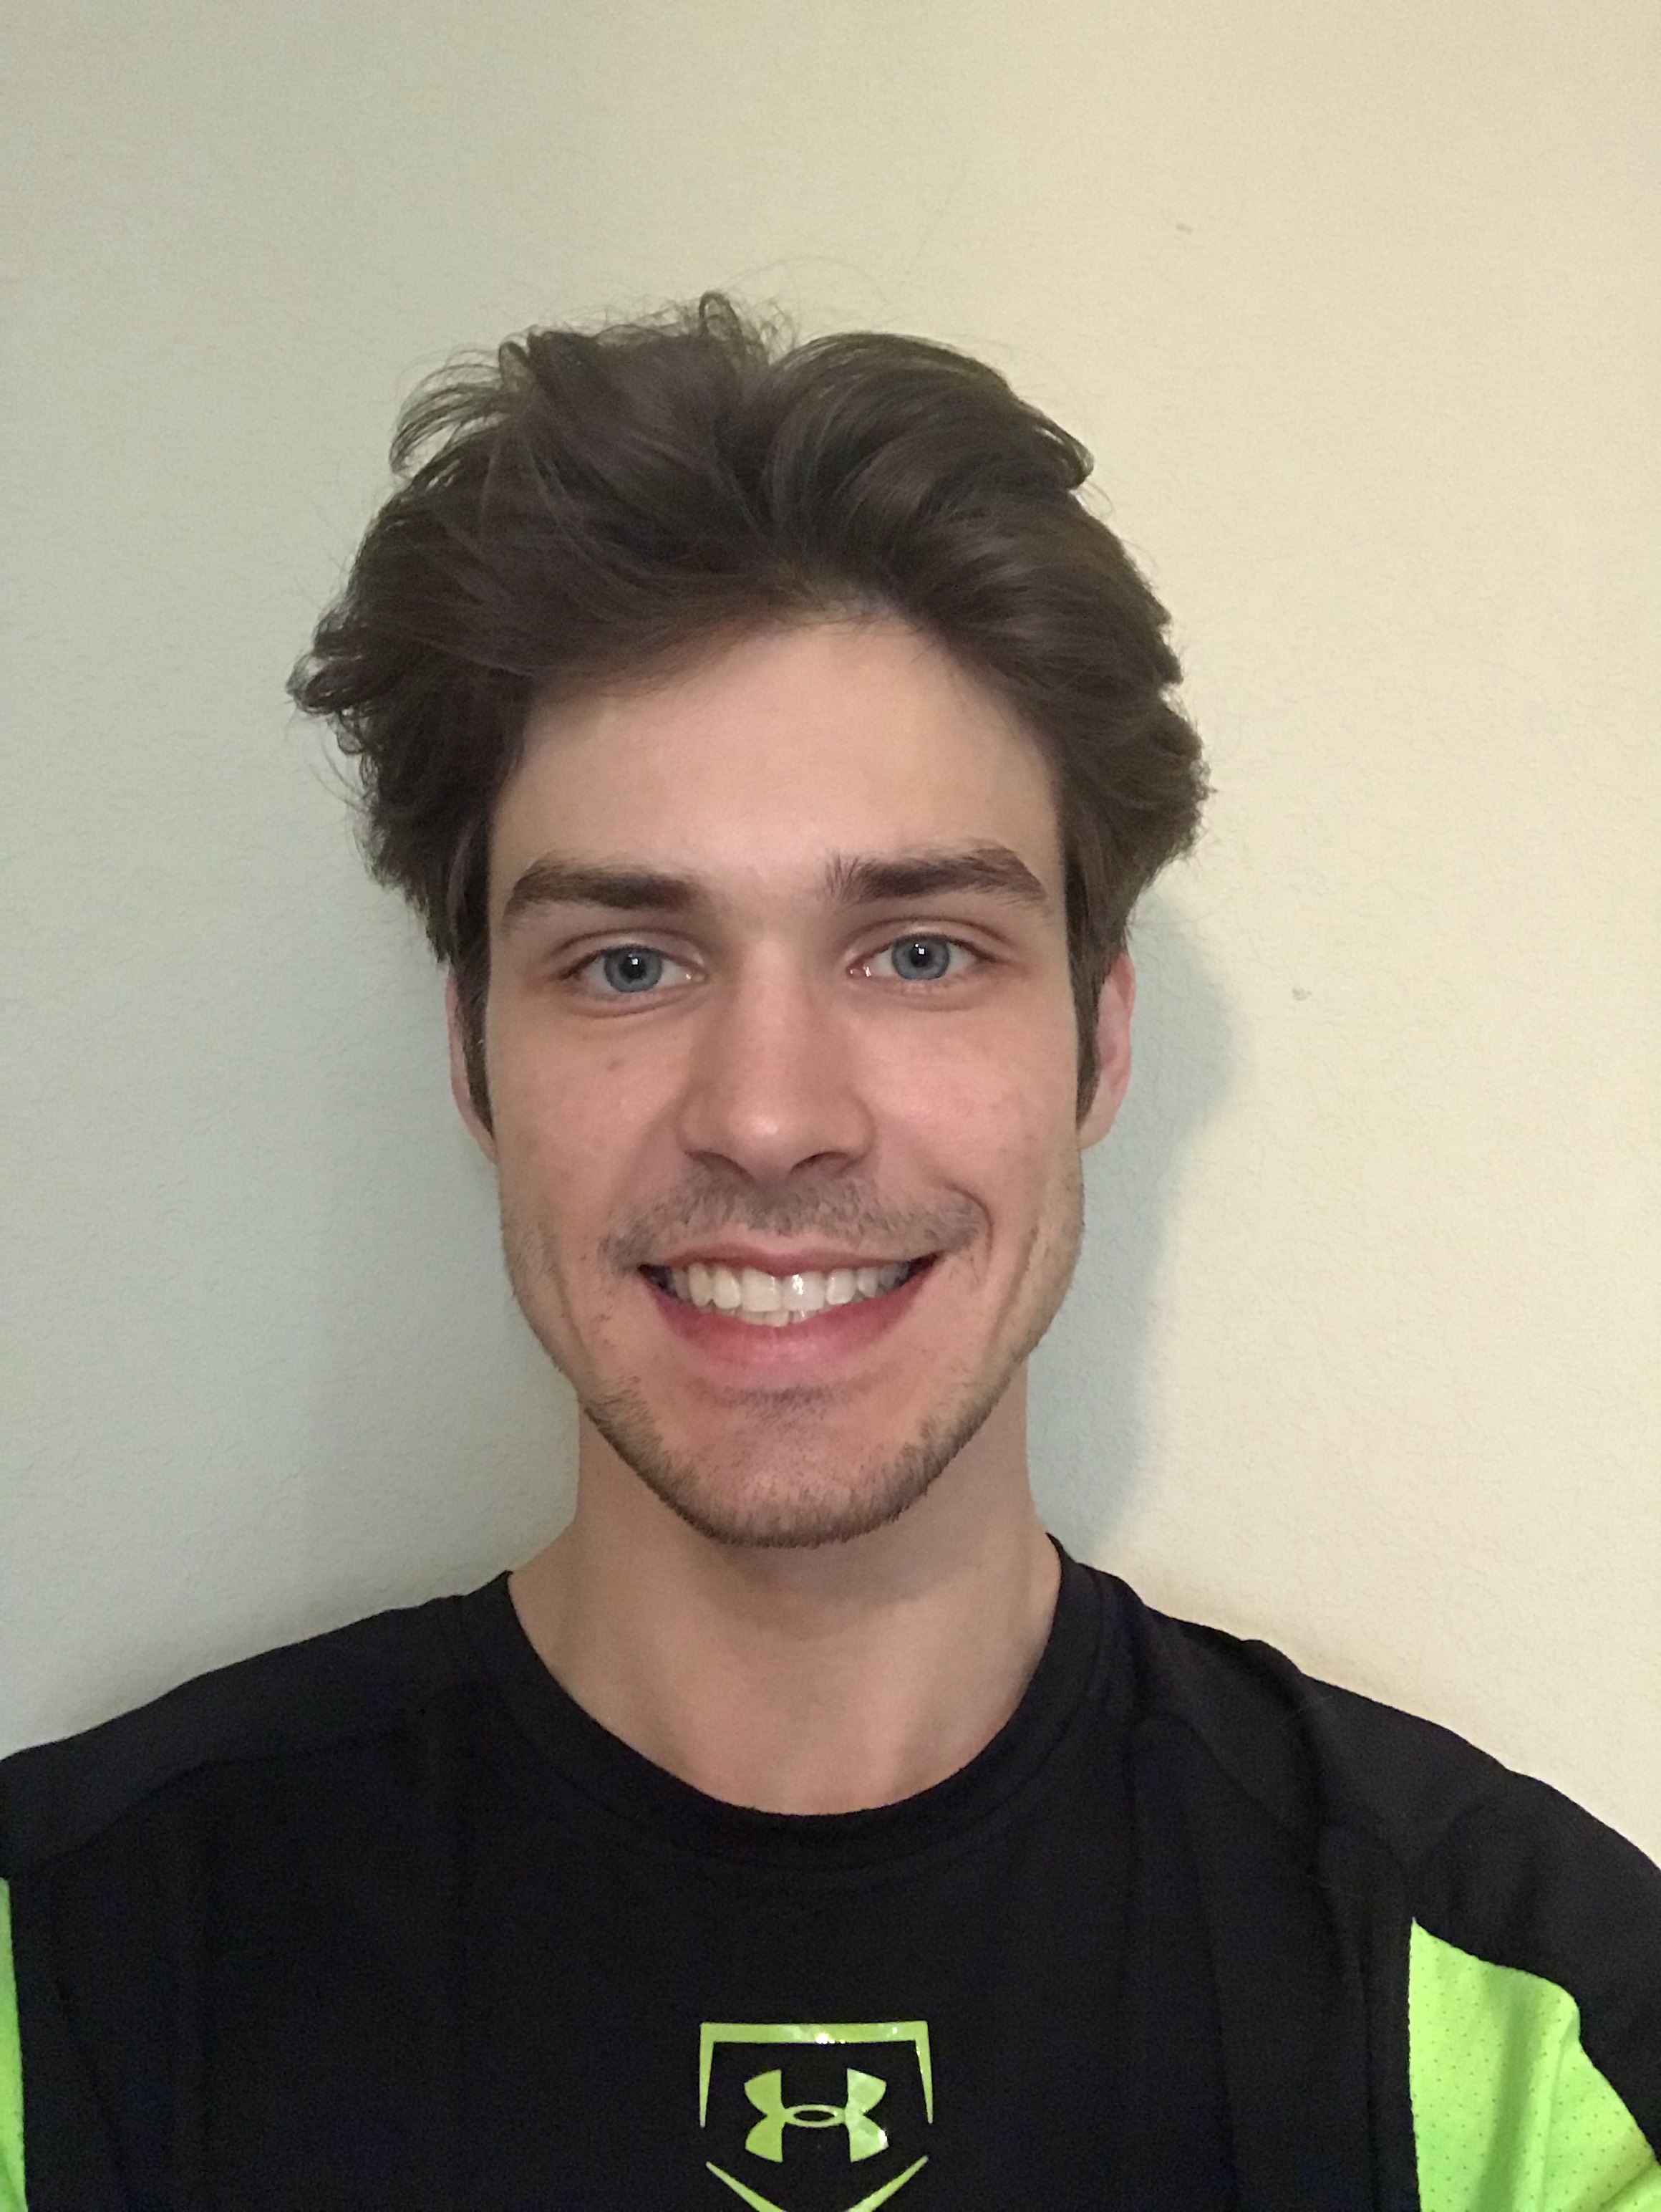
Coders
BRIAN PIGFORD
MAX CARDILLO
EMMANUEL MAKU
NICK
MYERS

Slide 3
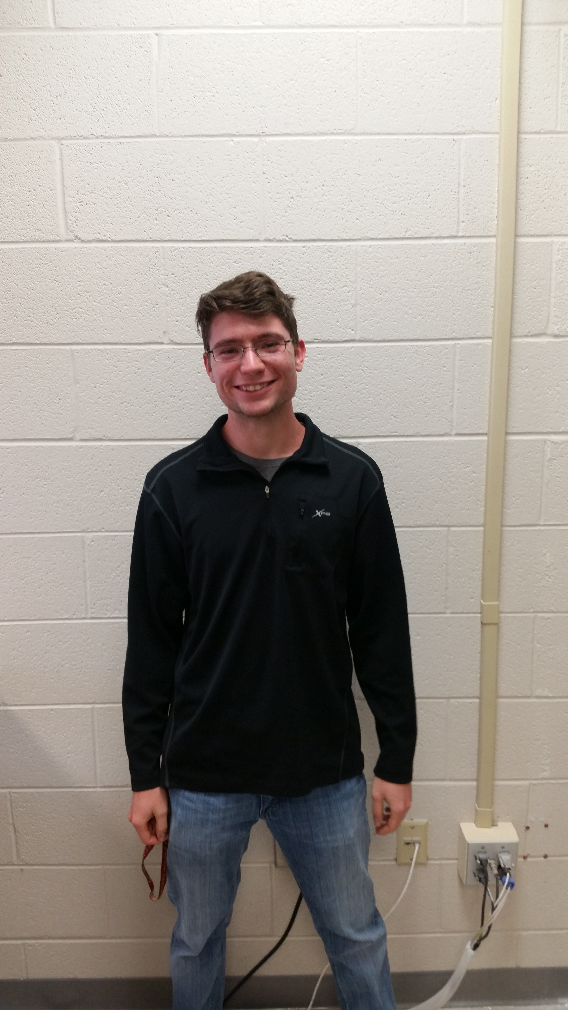
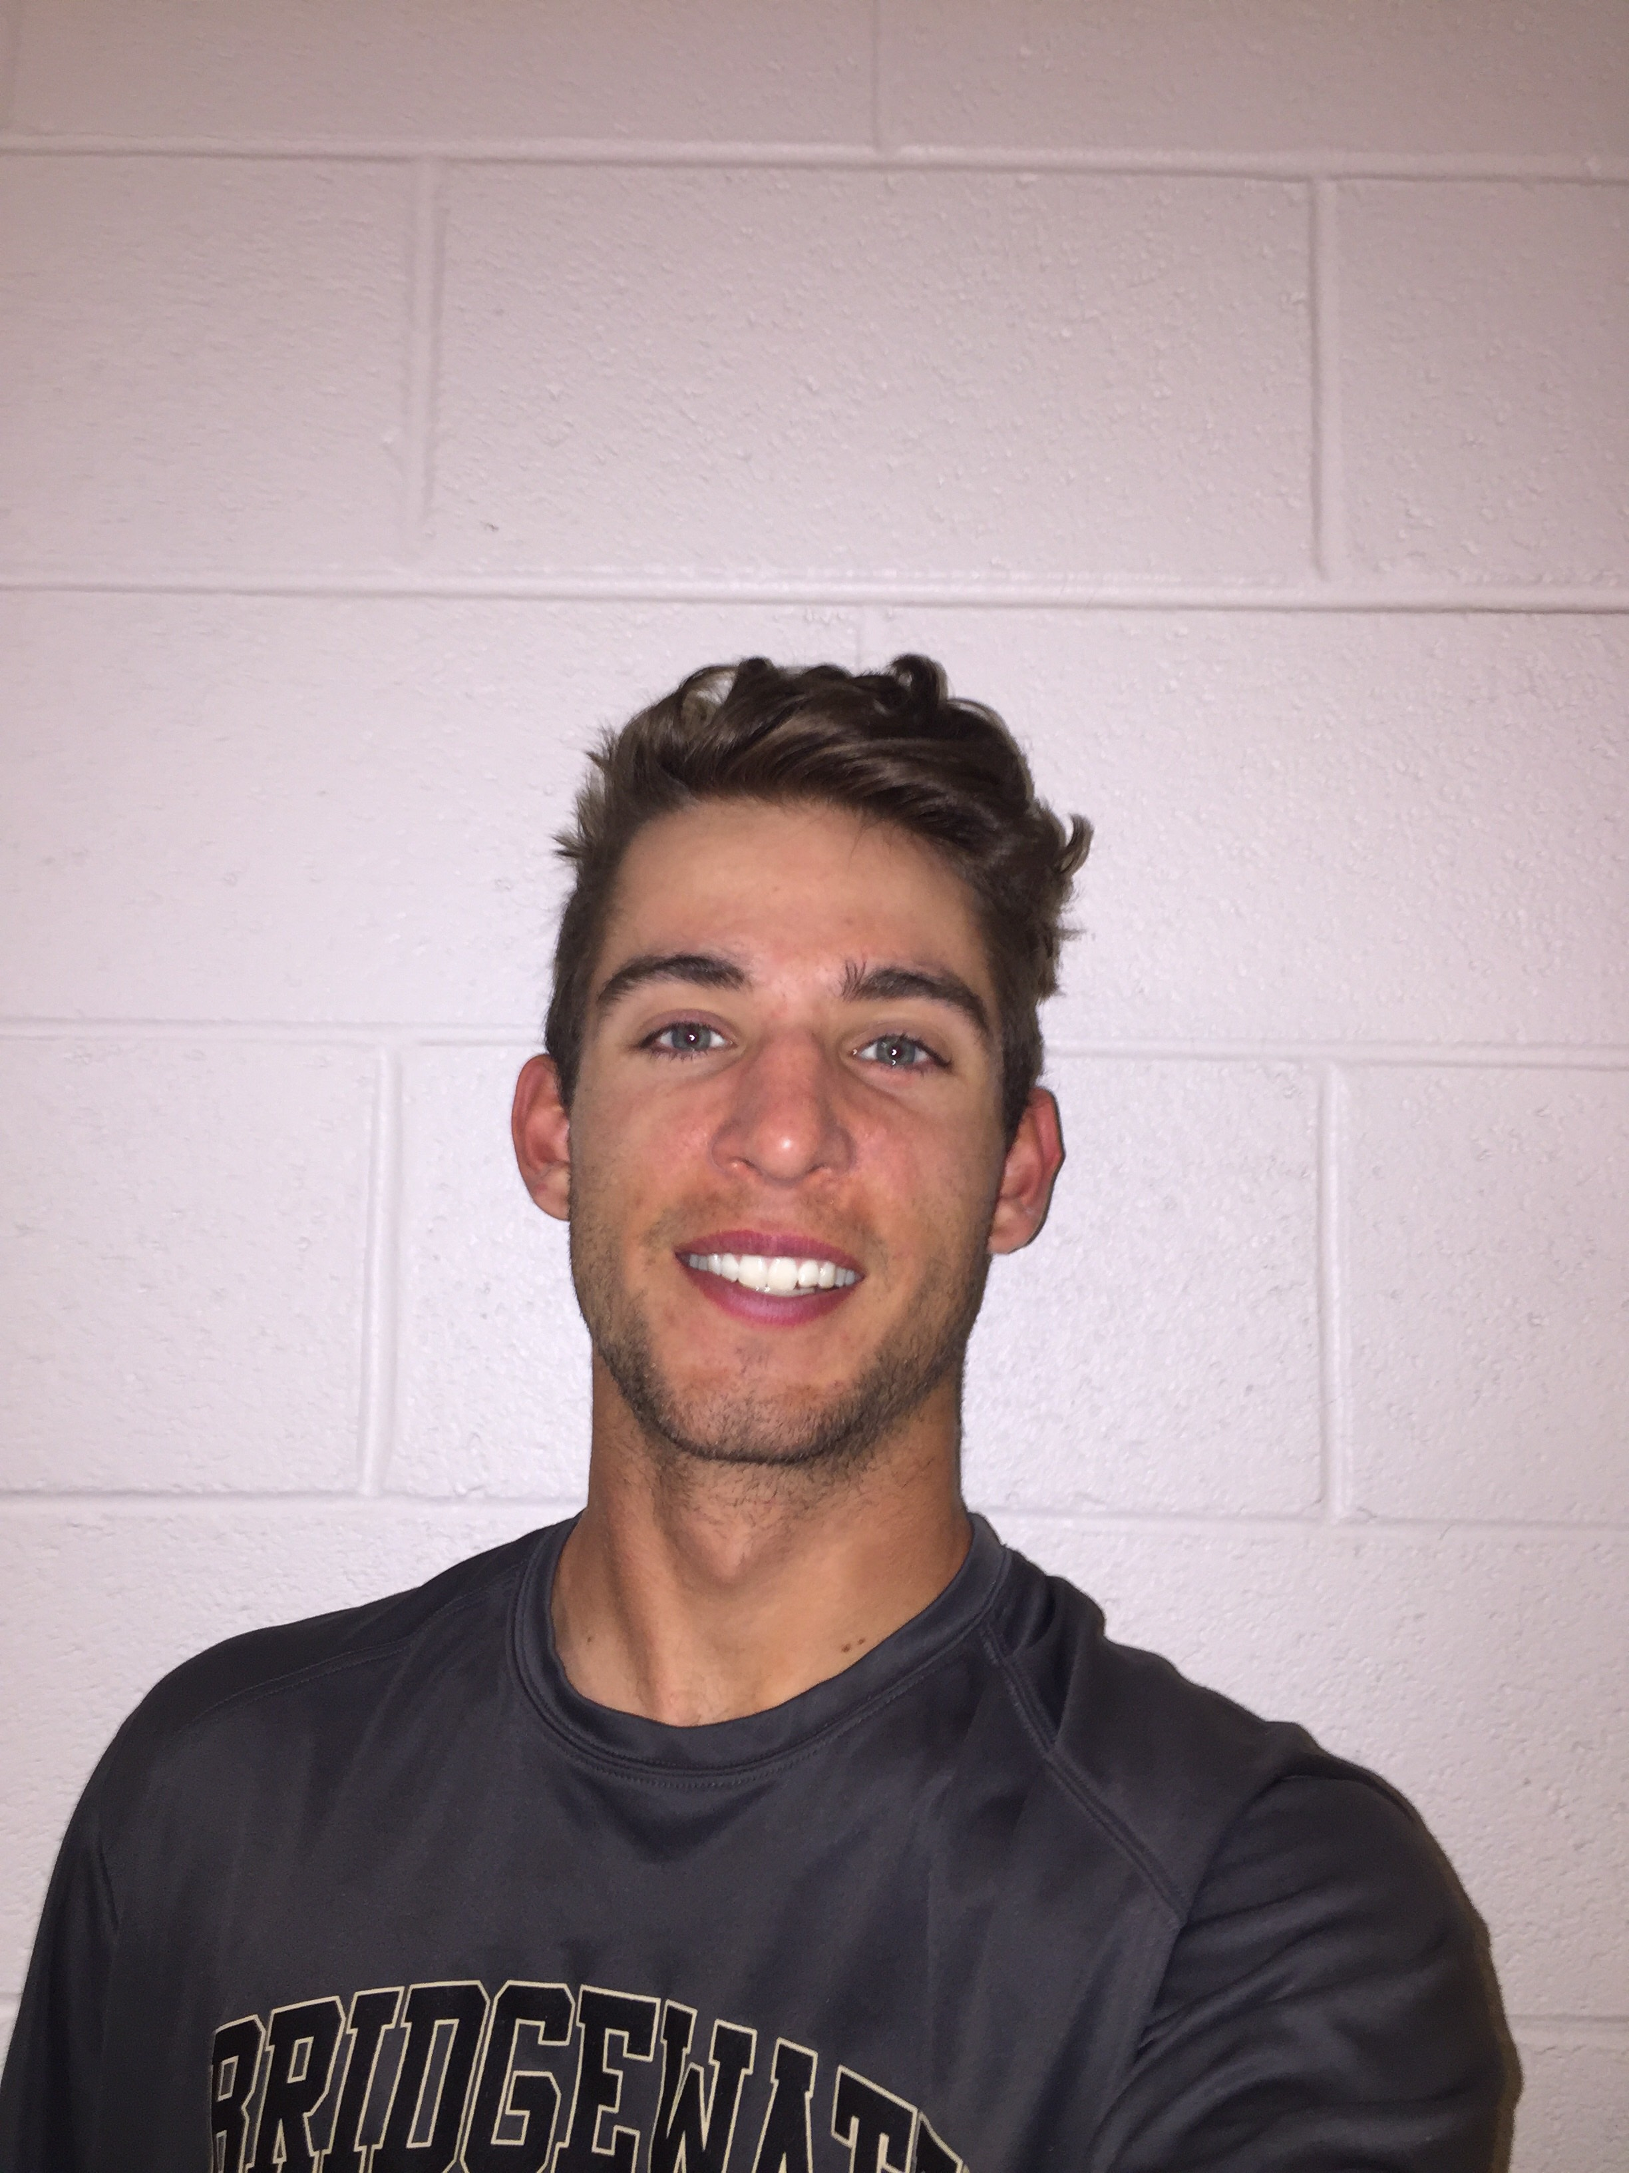
Website Designers
AUSTIN LANE
CHAD LENZ

Slide 4
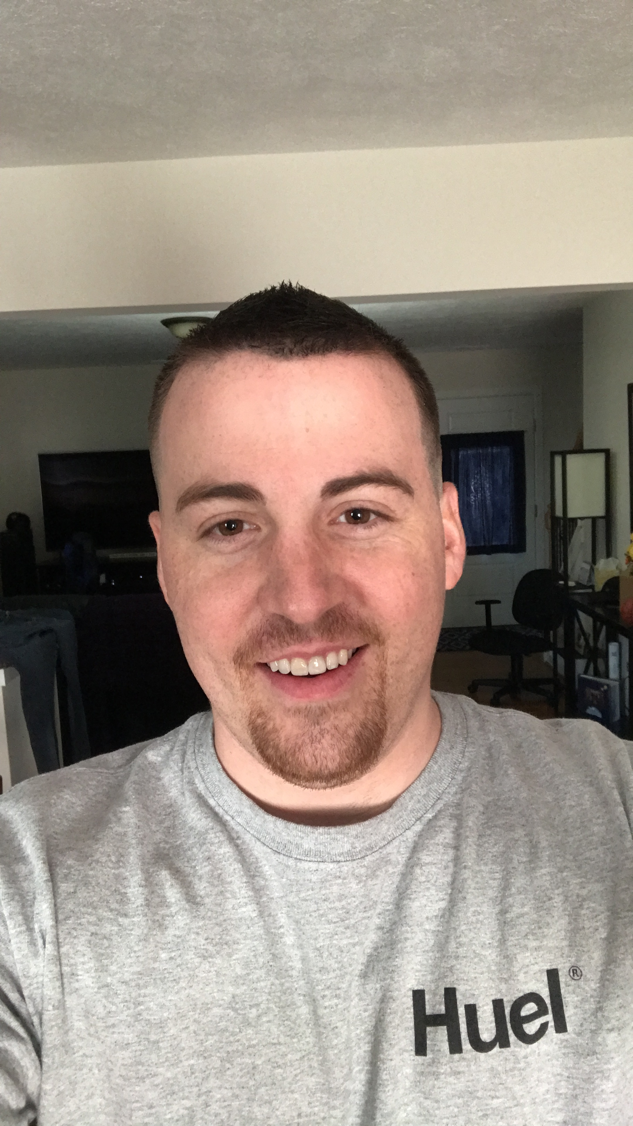
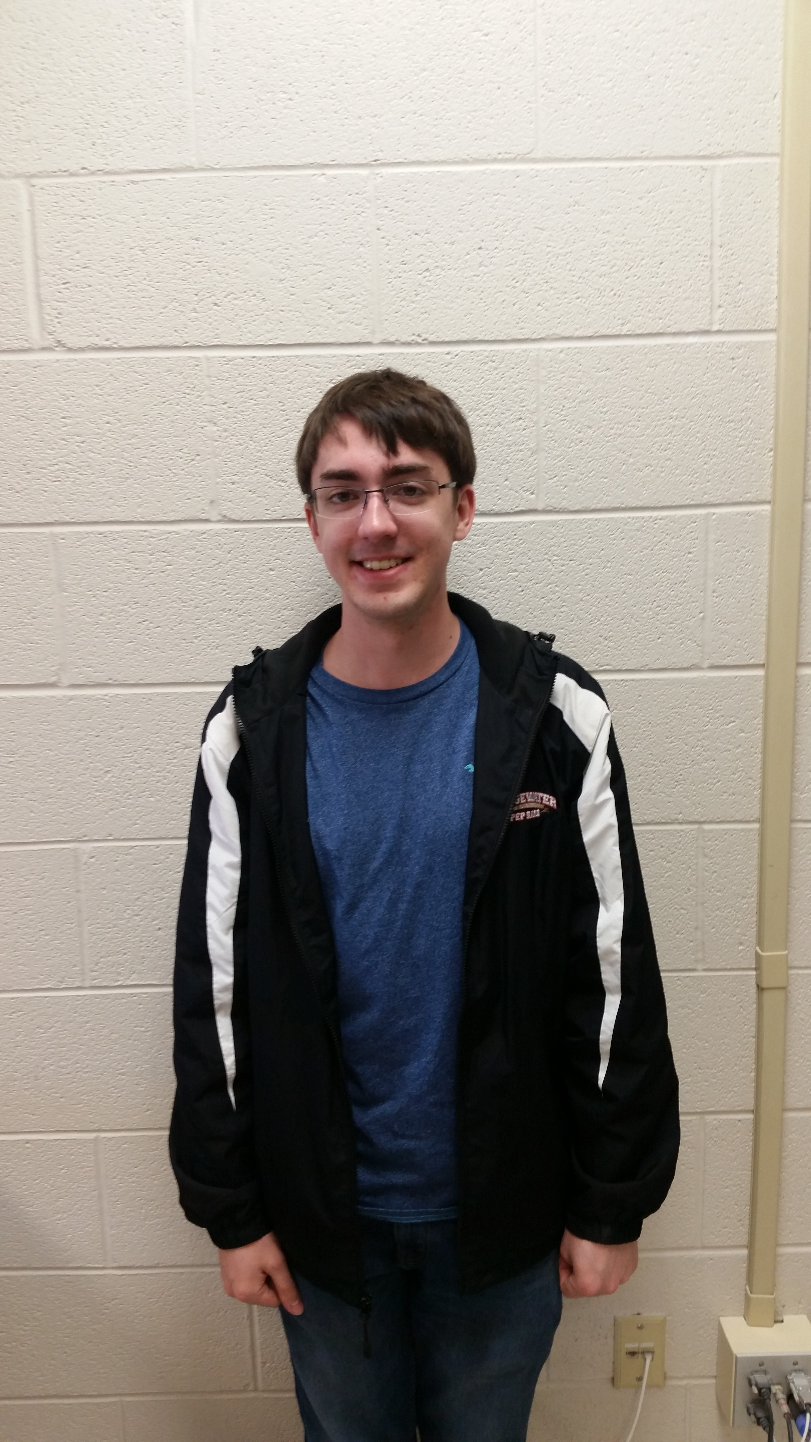
Documentation Team
MATT KELLEY
JOSEPH HAYS

Slide 5
Our problem
How could new students know which clubs are the best to try out?
How could club presidents receive feedback on how to improve their club?

Slide 6
Our plan
Create a website that allows for users to leave ratings for various clubs
Average those ratings together and display it
Display top clubs and schools on the homepage
Create admin accounts for each school to allow them to keep the club information up to date
Notes:
The top clubs displayed on the homepage change each time you refresh the page across all the top rated clubs in order to allow for exposure to all the clubs that have earned such a high rating.
We will create the admin account for a college after adding the college into the database and then we will send that login information to the student life office who could then login and add the clubs and update the info as it changes.

Slide 7
Planning
Researched similar sites to brainstorm common features
Established Use Cases
Defined software requirements
Projected timeline
Notes:
We researched similar sites like Rate my professor to gain inspiration. Then we had to think up any and all possible ways a user might use this website and write them all down in a Use Case Document. Then we had to define everything our software would need in order to fulfill those use cases. Things like a database to store comments, clubs, and user profiles. Finally we came up an estimate of when we would expect certain features to be completed and which features relied on other features to be developed before we could start them.

Slide 8
Challenges of programming
Integration (Mythical Man Month)
SQL
Timing/Pacing
Notes:
Since we were all working independently of each other sometimes our code wouldn’t mesh well together mostly through variable name differences and while we tried to impose a naming standard the only real solution was to comb through everyone’s code and rename the variables as needed. The SQL statements also presented a problem as SQL is extremely picky and not everyone was familiar with SQL and so more combing through had to be conducted to get the bugs out. Timing was another major problem schedules grew hectic and parts didn’t get completed on time causing delays for other team members.

Slide 9
Challenges of website design
Adapting to Bootstrap
Positioning/Sizing
Color palatte
Notes:
Our Design team had no previous experience with Bootstrap and so they had to adapt on the fly to how it worked in particular with the sizing and positioning of elements. Deciding on an appealing color palatte was difficult as none of us are art majors.

Slide 10
Challenges of Testing
Identifying all the possible test cases
Identifying the cause of the problem
Breaking other things while fixing others
Notes:
There are a lot of things that go wrong code and so our documentation team had to identify all of those things and figure out how and why they broke and report on it so the coding team could go in and fix all the problems. Unfortunately it was not that simple as often fixing one problem could cause another to crop up.

Slide 11
Challenges of documentation
Discovering all the minute changes made to use functionality
Constant updates
Discovery of new features
Notes:
As we developed the site we discovered small things that we hadn’t thought of before and thus we added them but this caused a challenge for the documentation team as they had to discovered what we thought of and add it in. We were also constantly going back over stuff and the site grew and so they had to go back and detect what changes we had made.

Slide 12
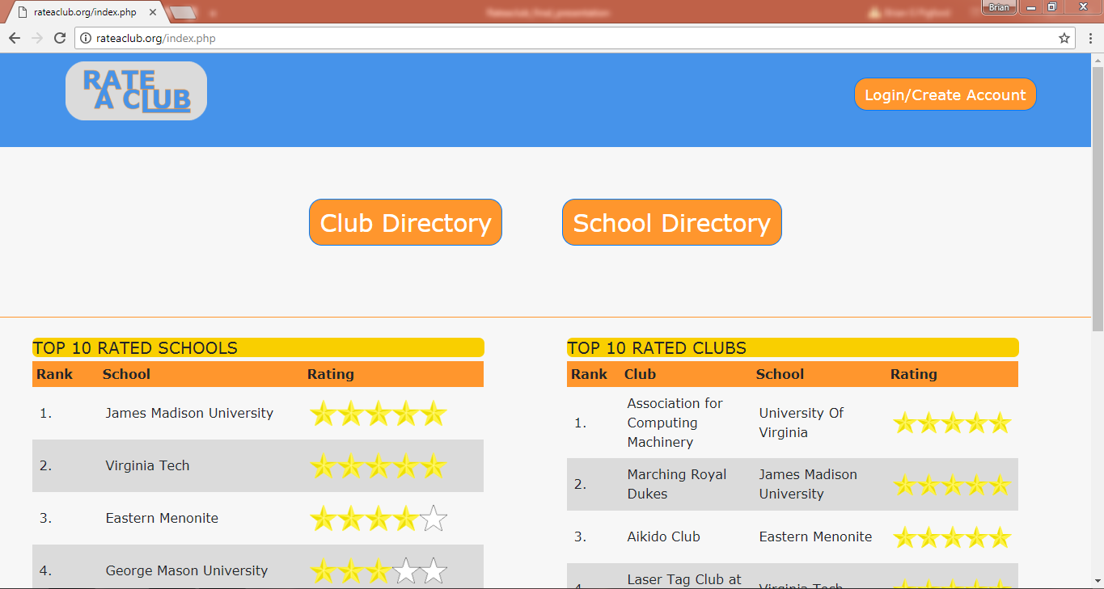
Screen shot of home page
Notes:
Here is the homepage when you first get to the page. You have the option to log in which lets you go to account management to manage your settings. You can see the top 10 clubs and you can see the top 10 colleges. Each row in the table is clickable and will redirect to the club/school page.

Slide 13
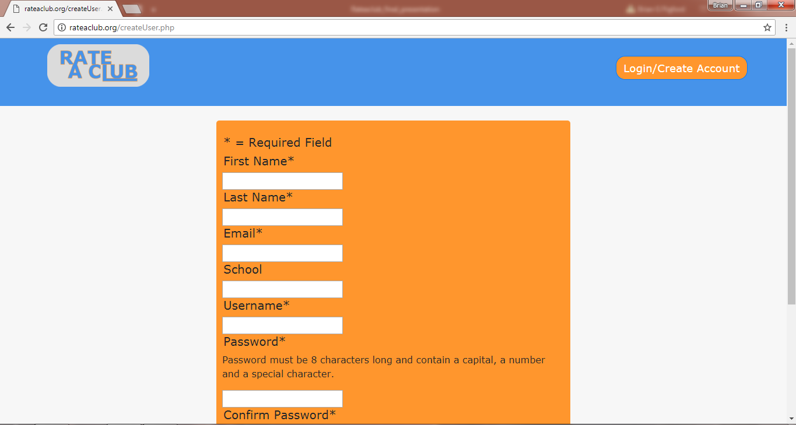
Screenshot of create user page
Notes:
Here new users can create a account by providing the required information. While accounts are not required to view ratings they are required to leave ratings.

Slide 14
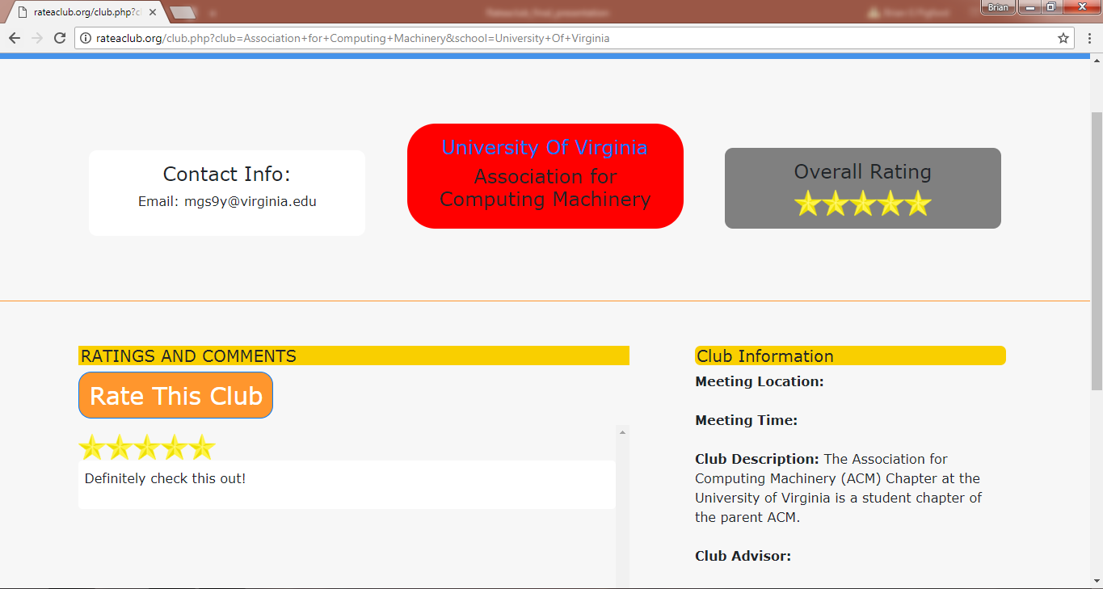
Screenshot of club page
Notes:
Here is a club page where users can view information about the club such as overall rating, what college its attached to, meeting info, a club description and contact email. The user can also leave comments and rate the club as well as view other peoples comments.

Slide 15
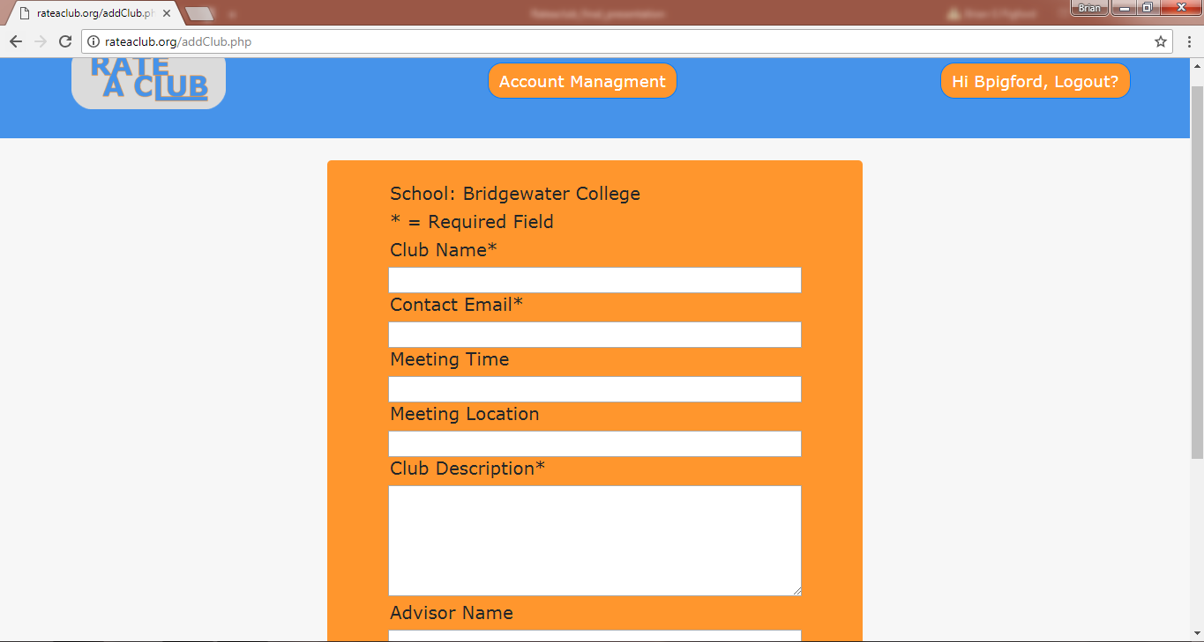
Screenshot of add club
Notes:
Here admins for the school can add new clubs by inputting the information for each field according to each individual schools privacy policy. Admins can also see what college they are adding the club for since it is auto set to the account’s school which they are unable to change.

Slide 16
Future development
Tags for clubs to allow for easier searching
Allow clubs to upload photos
User profile expansion
Emailing System for account recovery
Notes:
Like any good project we are never done with development. Some of the features we didn’t have time to add in that we would like to are tags to help organize clubs and help users locate clubs that match their interests. Allow for clubs to post some photos to show what they do. We would like to expand on the user profile and create a system to send emails through to allow users to reset their password if they forgot it in a secure fashion.

